Slide 1

HTTP Protocol
HTML Forms, HTTP Request & HTTP Response
SoftUni Team
Technical Trainers
Software University
https://softuni.bg

Slide 2
Table of Contents
HTTP Basics – Web Communication explained
HTTP Request
HTTP Response
HTML Forms – Method & Action
URL
Routing in Web
MIME & Media Types
Dev Tools

Slide 3
Have a Question?
sli.do #csharp-web

Slide 4
HTTP Basics
http://
Web Communication Explained

Slide 5



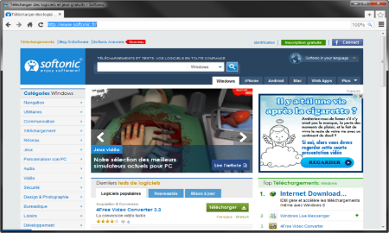





Web Server Work Model
Web Client
Web Server
Technology
Request
Response
Web Resources
Database
HTML, PDF, JPG…

Slide 6

Web Server Work Model
Web Client
Web Server
Technology
Request
.NET Core
Response
Web Resources
Database
HTML, PDF, JPG…

Slide 7


Hyper Text Transfer Protocol
Request
Response
HTTP
HTTP
TCP
TCP
IP
IP
Ethernet
Media (wires / air / fiber)
Ethernet
Notes:
HTTP == Hyper Text Transfer Protocol
Client-server protocol for transferring Web resources (HTML files, images, styles, scripts, data, etc.)
The widespread protocol for Internet communication today
Request-response model (client requests, server answers)
Text-based format (human readable)
Relies on unique resource URLs
Provides resource metadata (e.g. encoding)
Stateless (cookies and Web storages can overcome this)

Slide 8
HTTP Request Methods
Method | Description
POST | Create / store a resource
GET | Read / retrieve a resource
PUT | Update / modify a resource
DELETE | Delete / remove a resource
Other HTTP Methods
CONNECT
HEAD
OPTIONS
TRACE
The four basic functions of persistence storage.

Slide 9
HTTP Conversation: Example
GET /courses/javascript HTTP/1.1
Host: www.softuni.bg
User-Agent: Mozilla/5.0
<CRLF>
HTTP request:
HTTP response:
The empty line denotes the end of the request headers
HTTP/1.1 200 OK
Date: Mon, 5 Jul 2010 13:09:03 GMT
Server: Microsoft-HTTPAPI/2.0
Last-Modified: Mon, 12 Jul 2014 15:33:23 GMT
Content-Length: 54
<CRLF>
<html><title>Hello</title>
Welcome to our site</html>
The empty line denotes the end of the response headers

Slide 10
HTTP Request
What is a HTTP Request?

Slide 11
HTTP Request Message
HTTP request message sent by a client consists of:
HTTP request line
Request method (GET / POST / PUT / DELETE / …)
Resource URI (URL)
Protocol version
HTTP request headers
Additional parameters
HTTP request body
Optional data, e.g. posted form fields
<method> <resource> HTTP/<version>
<headers>
(empty line)
<body>

Slide 12
GET Request Method – Example
<form method="get">
Name: <input type="text" name="name" />
Age: <input type="text" name="age" />
<input type="submit" />
</form>
HTTP request line
GET /HTTP/1.1
Host: localhost
<CRLF>
HTTP request headers
The request body is empty

Slide 13
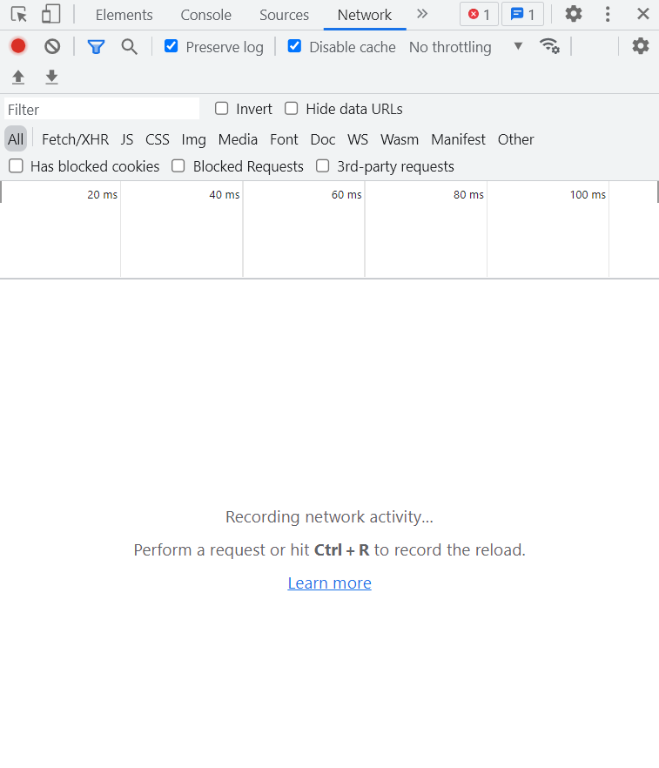
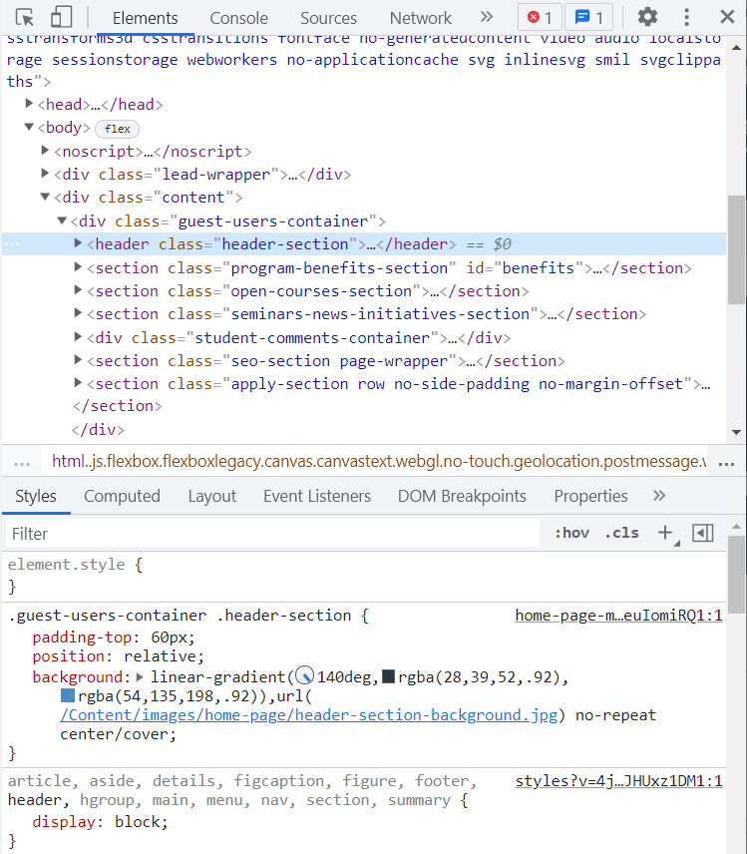
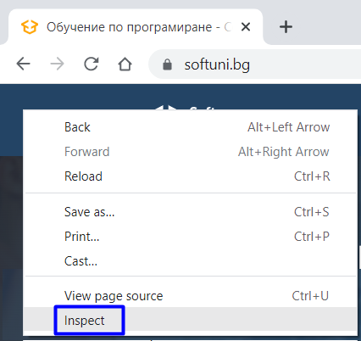
GET Request Method – Browser Example
Go to https://softuni.bg/
Right-click on the page and click on [Inspect] to open DevTools
Go to the [Network] tab

Slide 14
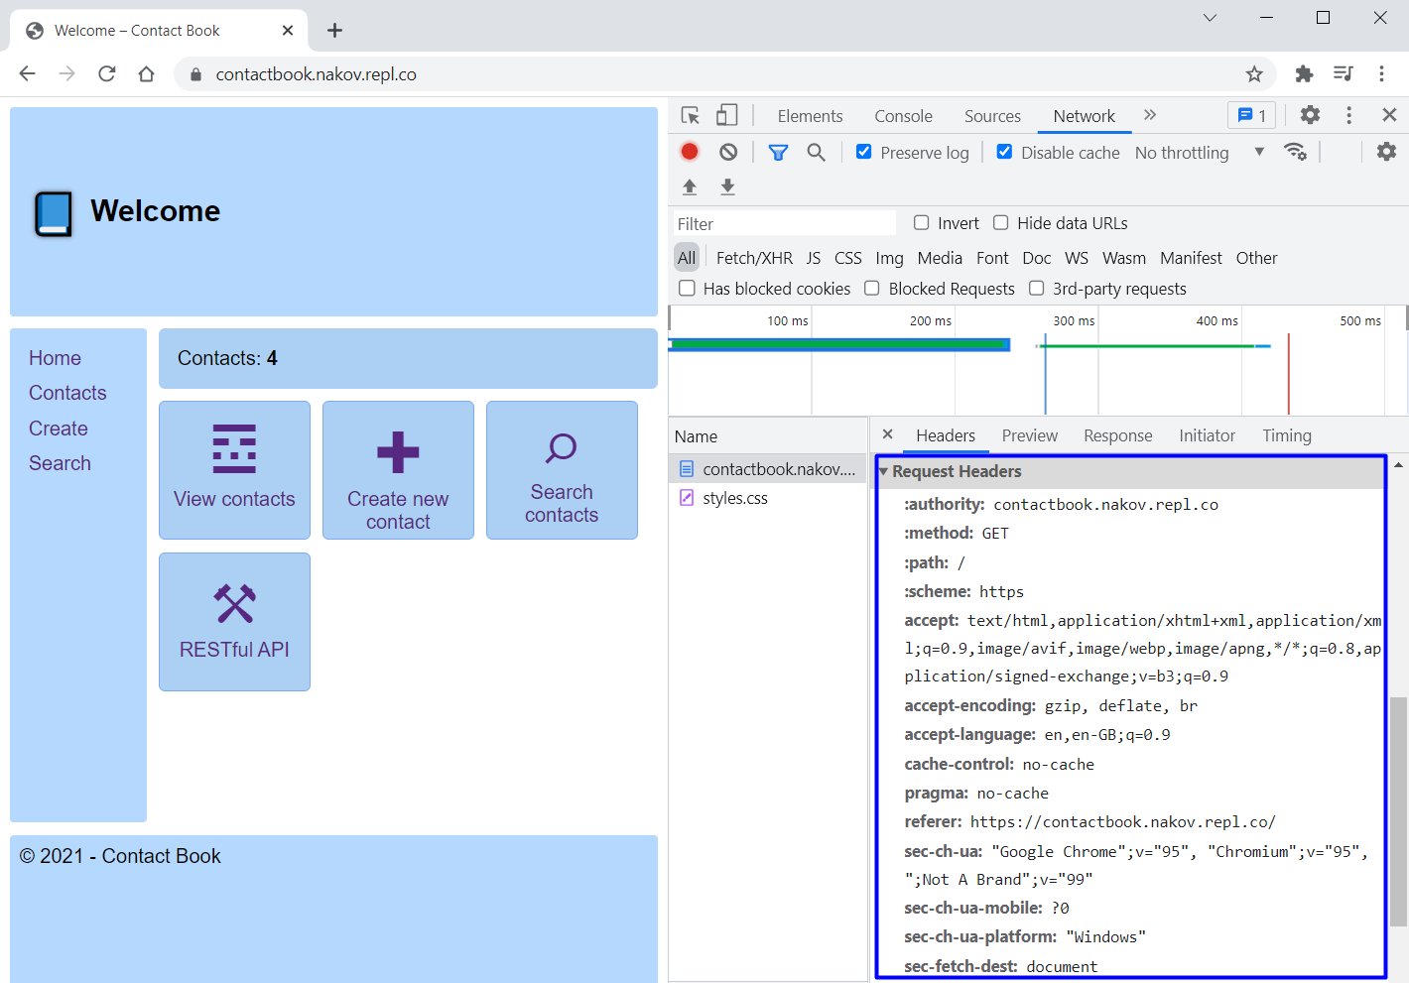
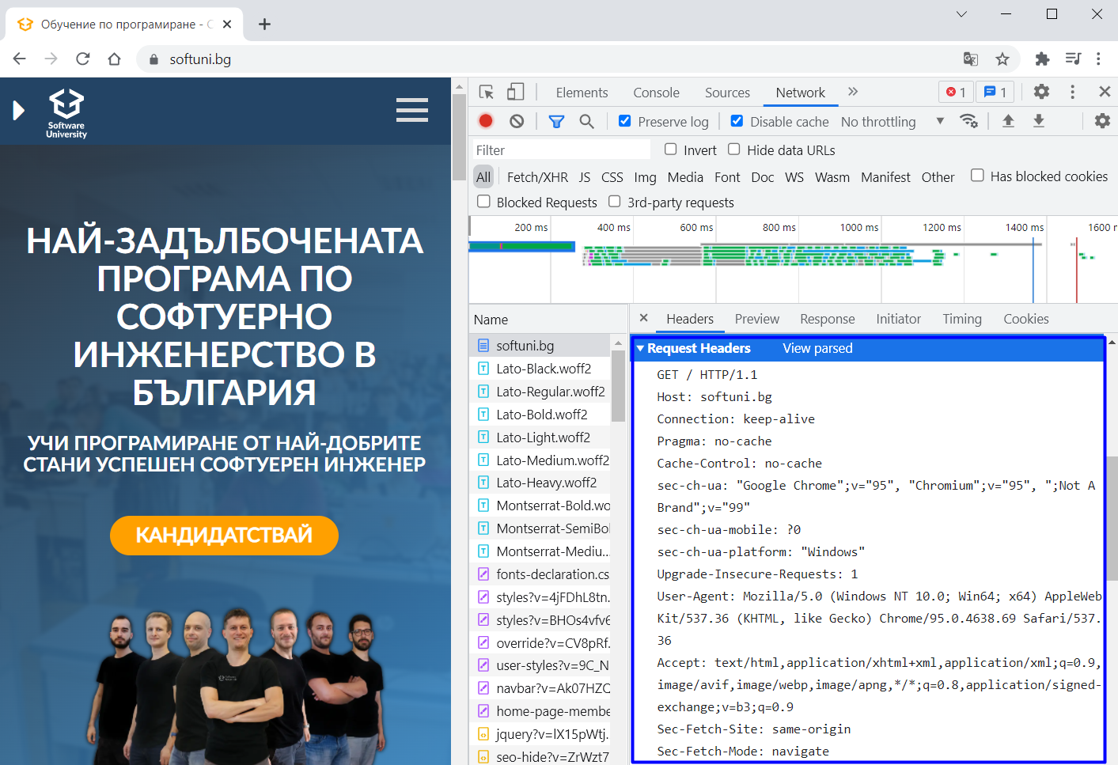
GET Request Method – Browser Example
Refresh the page
Examine the HTTP request headers
Open the Contact Book App and examine its GET requests, as well

Slide 15
POST Request Method – Example
The POST method transfers data in the HTTP body
POST can send text and binary data e.g. upload files
HTTP request line
POST /login HTTP/1.1
Host: localhost
Content-Length: 59
<CRLF>
username=mente&password=top*secret!
<CRLF>
HTTP request headers
The request body holds the submitted form data

Slide 16
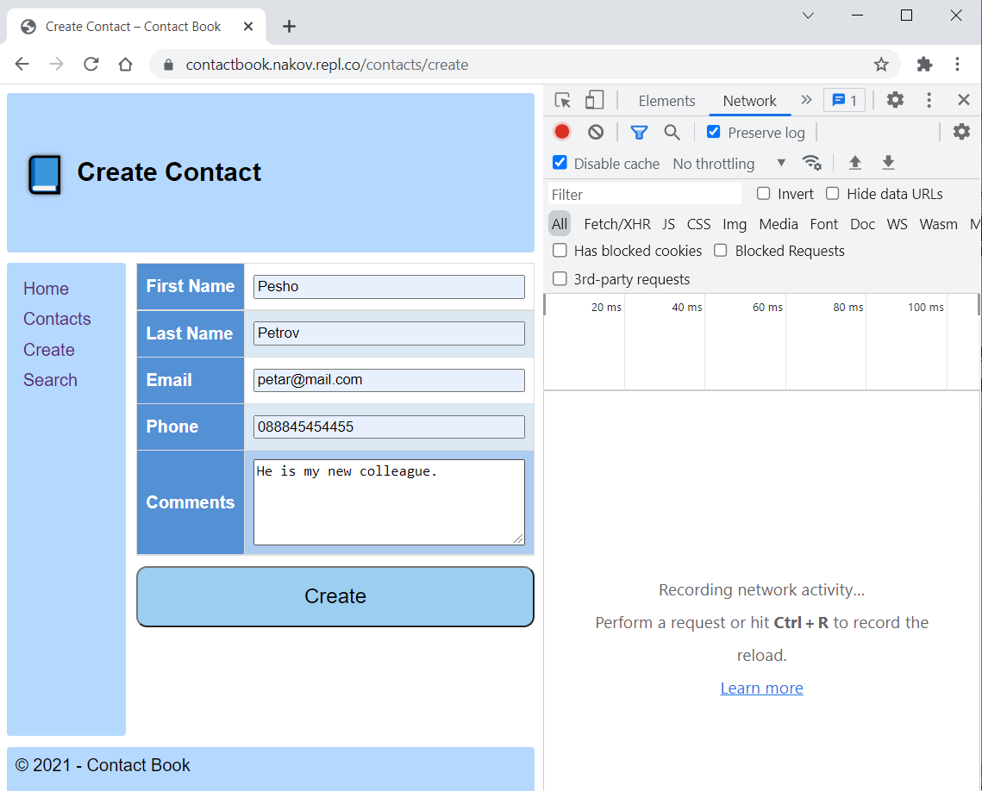
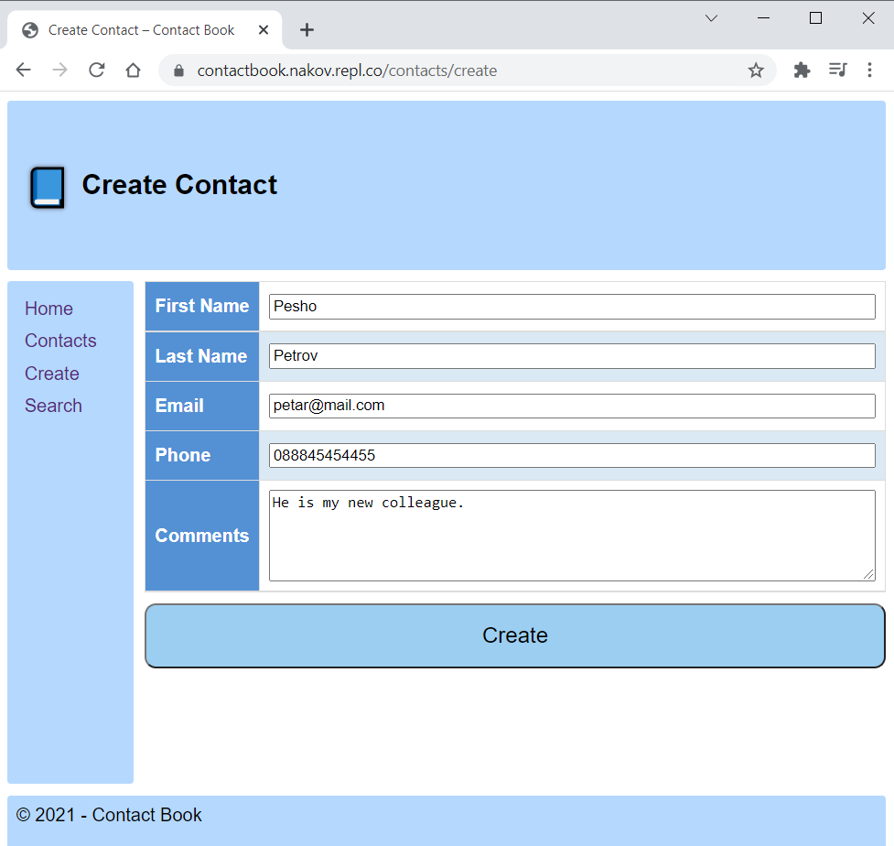
POST Request Method – Browser Example
Go to the "Create Contact" page in the Contact Book App
Fill in the form
Go to the Network tab in DevTools
Click on the [Create] button to send the form

Slide 17
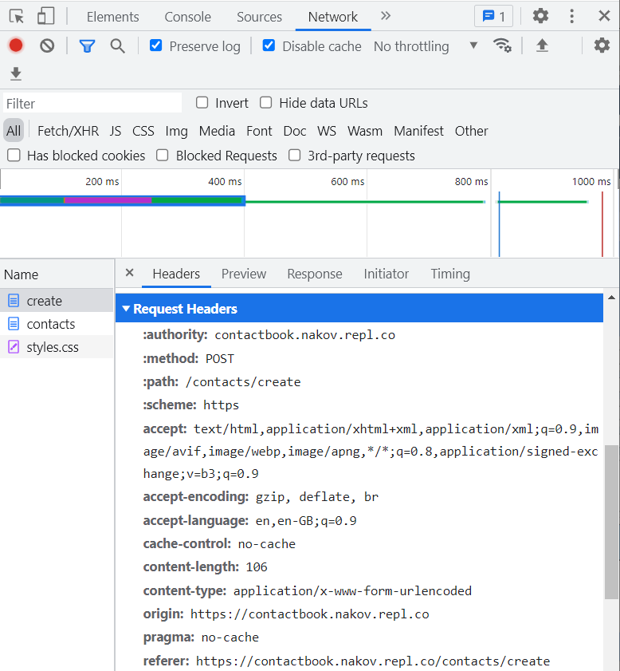
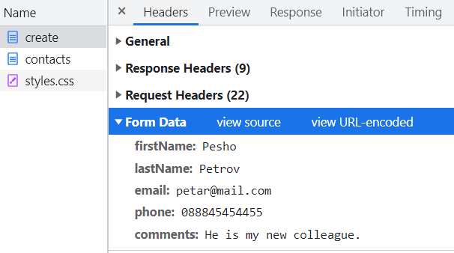
POST Request Method – Browser Example
Examine the POST request headers
The form data we sent is part of the HTTP Request

Slide 18

HTTP Response
What is a HTTP Response?

Slide 19
HTTP Response Message
The response message sent by the HTTP server consists of:
HTTP response status line
Protocol version
Status code
Status text
Response headers
Provide meta data about the returned resource
Response body
The content of the HTTP response (data)
HTTP/<version> <status code> <status text>
<headers>
<CRLF>
<response body – the requested resource>

Slide 20
HTTP Response Codes
HTTP response code classes
1xx: informational (e.g., "100 Continue")
2xx: successful (e.g., "200 OK", "201 Created")
3xx: redirection (e.g., "304 Not Modified", "301 Moved Permanently", "302 Found")
4xx: client error (e.g., "400 Bad Request", "404 Not Found", "401 Unauthorized", "409 Conflict")
5xx: server error (e.g., "500 Internal Server Error", "503 Service Unavailable")

Slide 21
HTTP Response – Example
Example of HTTP response from the Web server:
HTTP response status line
HTTP/1.1 200 OK
Date: Fri, 17 Jul 2010 16:09:18 GMT+2
Server: Apache/2.2.14 (Linux)
Accept-Ranges: bytes
Content-Length: 84
Content-Type: text/html
<CRLF>
<html>
<head><title>Test</title></head>
<body>Test HTML page.</body>
</html>
HTTP response headers
HTTP response body

Slide 22
HTTP Response – Example
Example of HTTP response with error result:
HTTP response status line
HTTP/1.1 404 Not Found
Date: Fri, 17 Nov 2014 16:09:18 GMT+2
Server: Apache/2.2.14 (Linux)
Connection: close
Content-Type: text/html
<CRLF>
<HTML><HEAD><TITLE>404 Not Found</TITLE></HEAD>
<BODY>
<H1>Not Found</H1>
The requested URL /img/logo.gif was not found on this server.<P> <HR><ADDRESS>Apache/2.2.14 Server at Port 80</ADDRESS>
</BODY></HTML>
HTTP response headers
The HTTP
response body

Slide 23
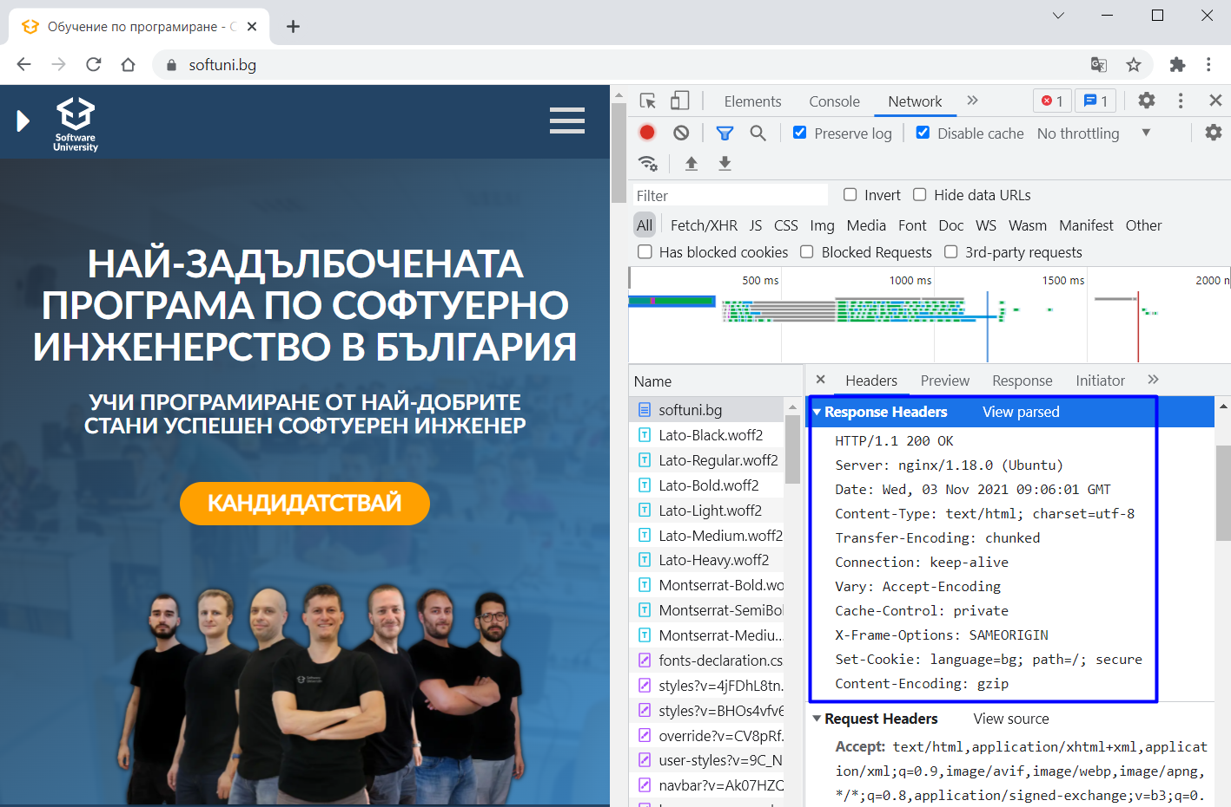
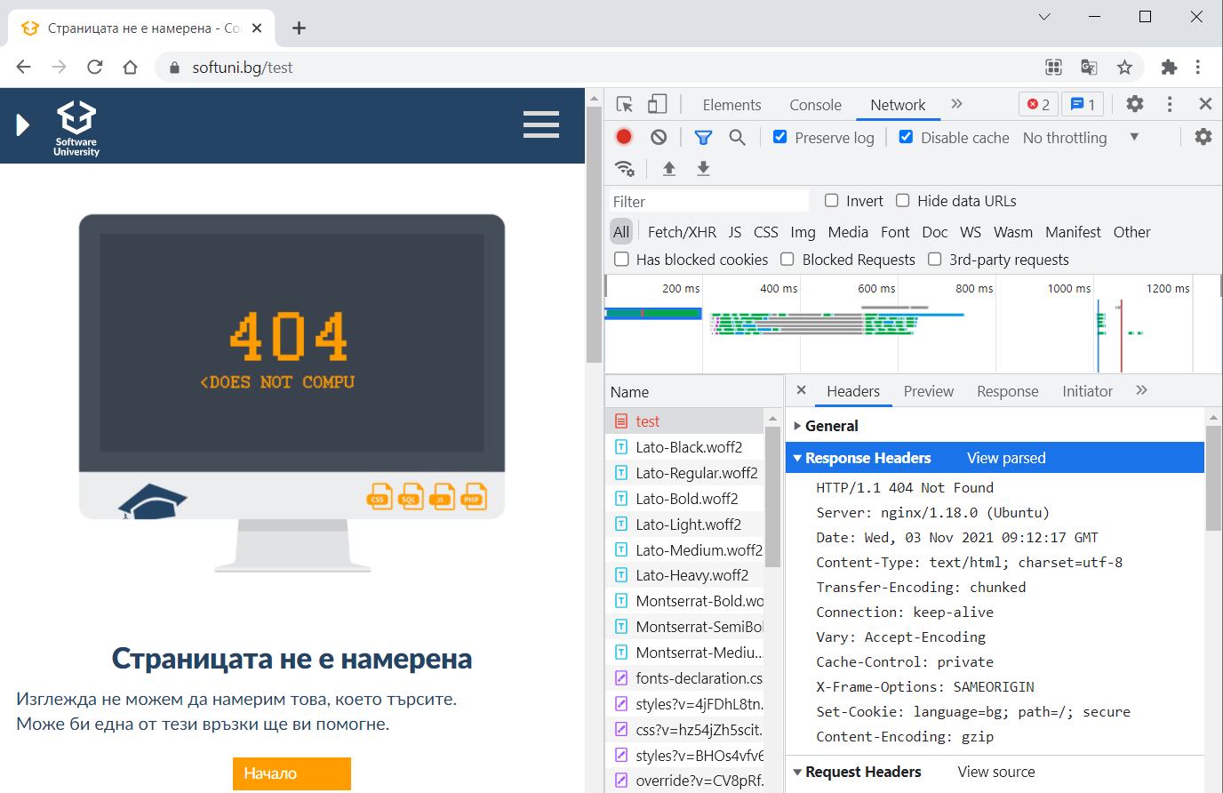
HTTP Response – Browser Example
Visit the SoftUni site
Examine the "OK" response
Go to an invalid URL https://softuni.bg/test
Examine the "Not Found" response

Slide 24
Browser Redirection
HTTP GET requesting a moved URL:
The following HTTP response (301 Moved Permanently) tells the browser to request another URL:
GET / HTTP/1.1
Host: http://softuni.org
User-Agent: Gecko/20100115 Firefox/3.6
<CRLF>
HTTP/1.1 301 Moved Permanently
Location: http://softuni.bg
...

Slide 25
Content-Type and Disposition
With Content-Type response header the server specifies how the output should be processed
Examples:
UTF-8 encoded HTML page. Will be shown in the browser.
Content-Type: text/html; charset=utf-8
Content-Type: application/pdf
Content-Disposition: attachment; filename="Report-April-2016.pdf"
This will download a PDF file named Report-April-2016.pdf

Slide 26
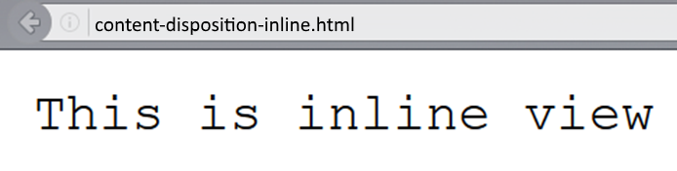
Content-Disposition – Example
Content-Type: text/plain
Content-Length: 19
Content-Disposition: inline filename=example.txt

Slide 27
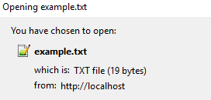
Content-Disposition – Example
Content-Type: text/plain
Content-Length: 19
Content-Disposition: attachment; filename=example.txt

Slide 28

HTML Forms
Form Method and Action

Slide 29
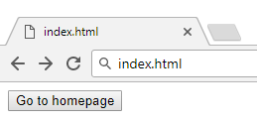
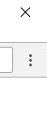
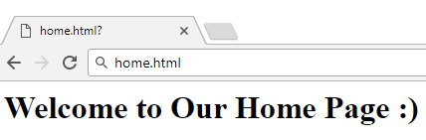

HTML Forms – Action Attribute
Relative URL to the current file
<form action="home.html">
<input type="submit" value="Go to homepage"/>
</form>
Defines where to submit the form data:

Slide 30
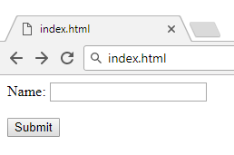

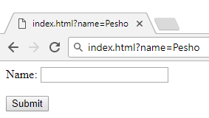

HTML Forms – Method Attribute (1)
Specifies the HTTP method to use when sending form data
<form method="get"> Name: <input type="text" name="name"> <br /><br />
<input type="submit" value="Submit">
</form>
The form data is in the URL

Slide 31
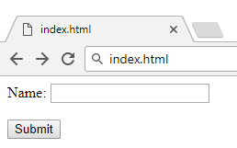

HTML Forms – Method Attribute (2)
<form method="post"> Name: <input type="text" name="name"> <br /><br />
<input type="submit" value="Submit">
</form>
Headers will be explained later
POST http://localhost/index.html HTTP/1.1
Host: localhost
Content-Type: application/x-www-form-urlencoded
Content-Length: 10
name=Pesho
HTTP request body holds the request form data and the response data

Slide 32
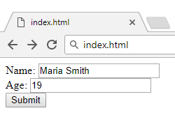
URL Encoded Form Data – Example
<form method="post">
Name: <input type="text" name="name"/> <br/>
Age: <input type="text" name="age"/> <br/>
<input type="submit" />
</form>
POST http://localhost/cgi-bin/index.cgi HTTP/1.1
Host: localhost
Content-Type: application/x-www-form-urlencoded
Content-Length: 23
name=Maria+Smith&age=19
File uploads are not supported

Slide 33
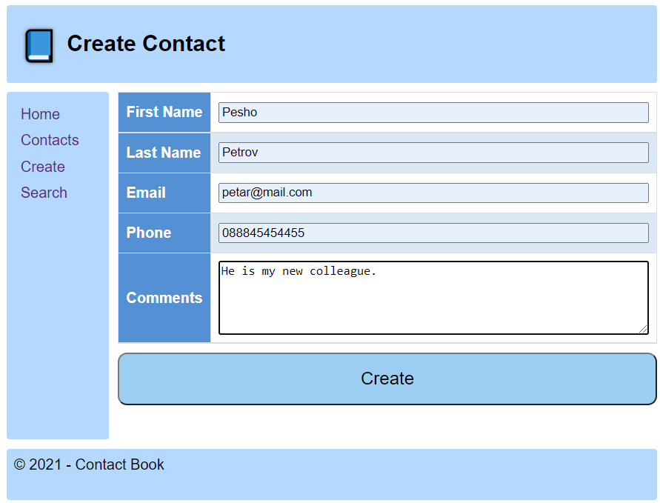
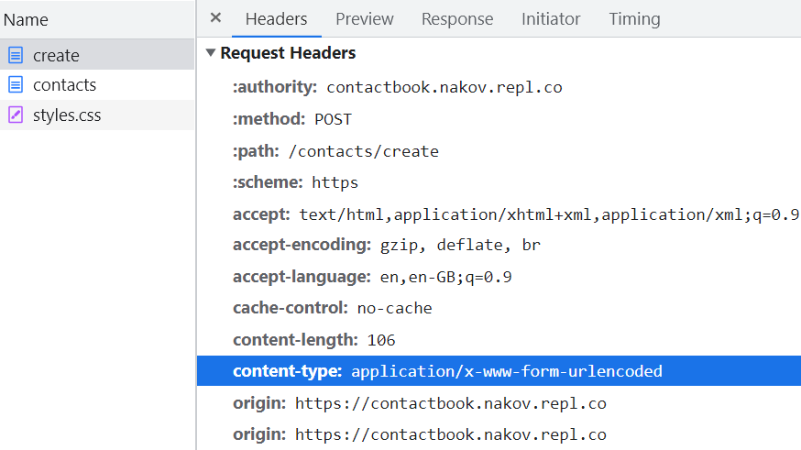
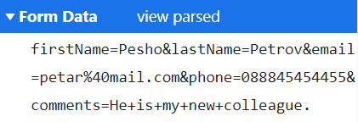
HTML Forms – Example
Submit the “Create Contact” form in the Contact Book App
Examine the request content type and
form data in the DevTools Network tab

Slide 34

URL
Uniform Resource Locator

Slide 35
Uniform Resource Locator (URL)
http://mysite.com:8080/demo/index.php?id=27&lang=en#lectures
Protocol
Host
Port
Path
Query String
Fragment
URL is a formatted string, consisting of:
Protocol for communicating (http, ftp, https...) – HTTP in most cases
Host or IP address (www.softuni.bg, gmail.com, 127.0.0.1, web)
Port (the default port is 80) – a number in range [0…65535]
Path (/forum, /path/index.php)
Query string (?id=27&lang=en)
Fragment (#lectures) – used on the client to navigate to some section

Slide 36
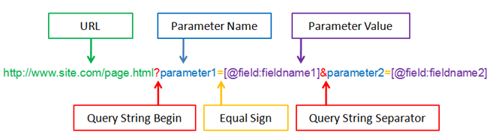
Query String in C#
Query string contains data that is not part of the path structure
Commonly used in searches and dynamic pages
It is the part of a URL following a question mark (?)
Multiple parameters are separated by some delimiter
http://example.com/path/to/page?name=ferret&color=purple

Slide 37
URL Encoding
URLs are encoded according RFC 1738:
Unreserved URL characters – have no special meaning
Reserved URL characters – can have a special meaning in the URL
Reserved characters are escaped by percent encoding
Space is encoded as "+" or "%20"
[0-9a-zA-Z]
! * ' ( ) ; : @ & = + $ / , ? # [ ]
%[character hex code]

Slide 38
URL Encoding – Examples
All other characters are escaped by %
Char | URL Encoding
space | %20
щ | %D1%89
" | %22
# | %23
$ | %24
% | %25
& | %26
Each character is converted to its ASCII value, represented as hexadecimal digits
Наков-爱-SoftUni
%D0%9D%D0%B0%D0%BA%D0%BE%D0%B2-%E7%88%B1-SoftUni

Slide 39
Valid and Invalid URLs – Examples
Some valid URLs:
An invalid URL:
http://www.google.bg/search?sourceid=navclient&ie=UTF-8&rlz=1T4GGLL_enBG369BG369&q=http+get+vs+post
http://bg.wikipedia.org/wiki/%D0%A1%D0%BE%D1%84%D1%82%D1%83%D0%B5%D1%80%D0%BD%D0%B0_%D0%B0%D0%BA%D0%B0%D0%B4%D0%B5%D0%BC%D0%B8%D1%8F
Should be: C%23+.NET+4.0
http://www.google.bg/search?&q=C# .NET 4.0

Slide 40
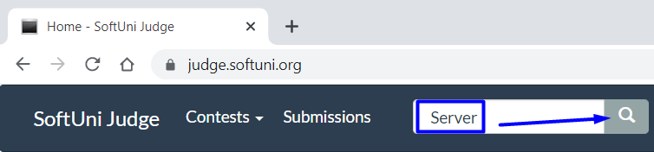
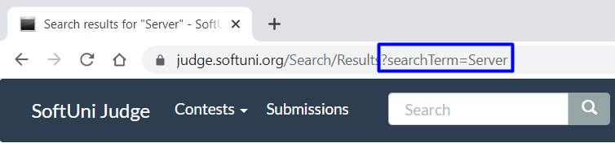
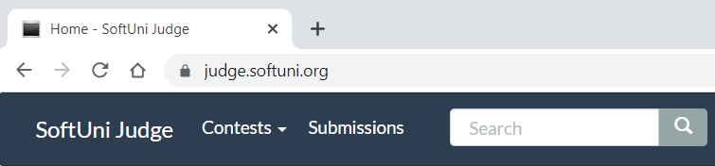
URLs Example
Open the SoftUni Judge system
Add a search keyword in the "Search" field
Click on the search button
Examine the URL – it contains the search term

Slide 41
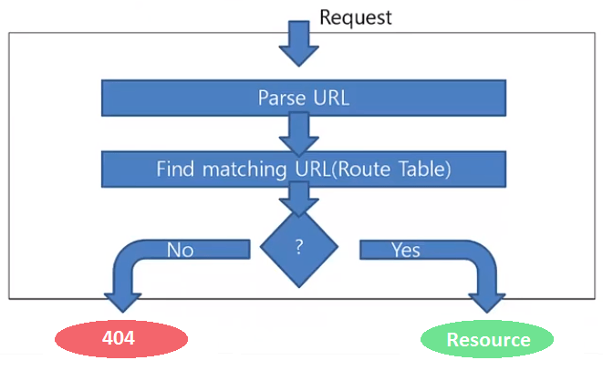
Routing
Mapping HTTP Request to HTTP Responses

Slide 42
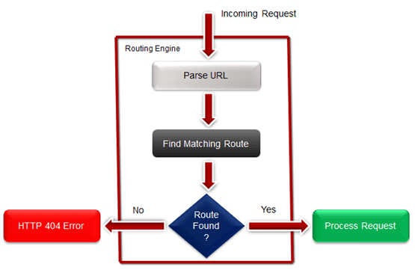
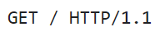
What is Web Routing?
Web Routing is a mechanism where HTTP requests are routed to the code that handles them
Requests are routed based on the HTTP
request method and the request path
HTTP requests are mapped
to HTTP responses
Example: route “/” is often
mapped to the app’s Home page

Slide 43
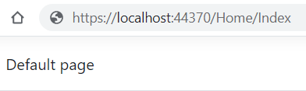
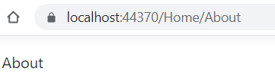
Mapping Physical Files
RouteTable.Routes.MapPageRoute
Route Name | Route URL | Physical File Name
Home | Home/Index | Index.html
About | Home/About | About.html
User-friendly URL replacement of the physical file name
void RegisterRoutes(RouteCollection routes)
{
routes.MapPageRoute("Home","Home/Index","/wwwroot/Home/Index.html");
routes.MapPageRoute("About","Home/About","/wwwroot/Home/About.html");
}

Slide 44
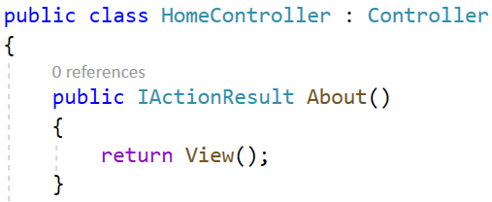
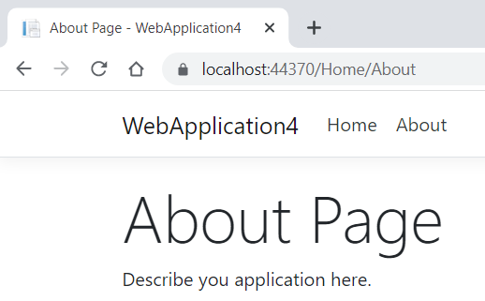
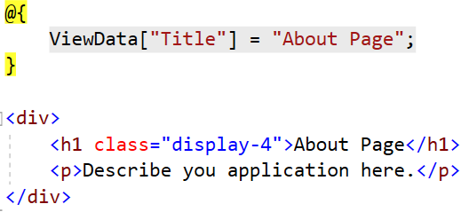
Routing in ASP.NET Core MVC
In MVC actions in controllers are mapped to .cshtml files (views)
Controller
Action
void RegisterRoutes(RouteCollection routes) {
// Default Route
routes.MapRoute(
name: “default",
url: "{controller}/{action}/{id}",
defaults: new { controller="Home", action="Index", id=UrlParameter.Optional }
}
Optional

Slide 45

MIME and Media Types
Multi-purpose Internet Mail Extensions

Slide 46
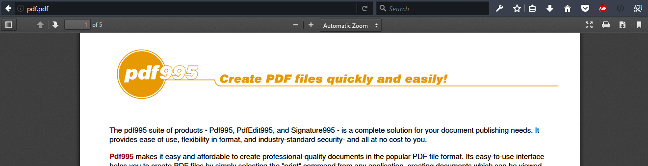
What is MIME?
MIME == Multipurpose Internet Mail Extensions
Internet standard for encoding resources
Originally developed for email attachments
Used in many internet protocols like HTTP and SMTP

Slide 47





Concepts of MIME
Content-Type - media type of the message content
text/html, image/gif, application/pdf
Content-Disposition - specifies the presentation style
attachment; filename=logo.jpg
Multipart messages - multiple resources in a single document

Slide 48
Common MIME Media Types
MIME Type / Subtype | Description
application/json | JSON data
image/png | PNG image
image/gif | GIF image
text/html | HTML
text/plain | Text
text/xml | XML
video/mp4 | MP4 video
application/pdf | PDF document

Slide 49
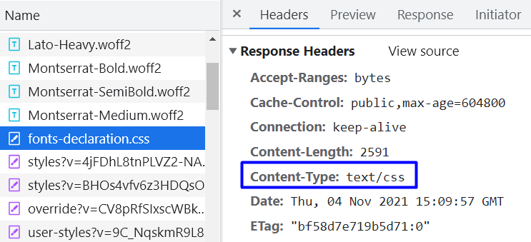
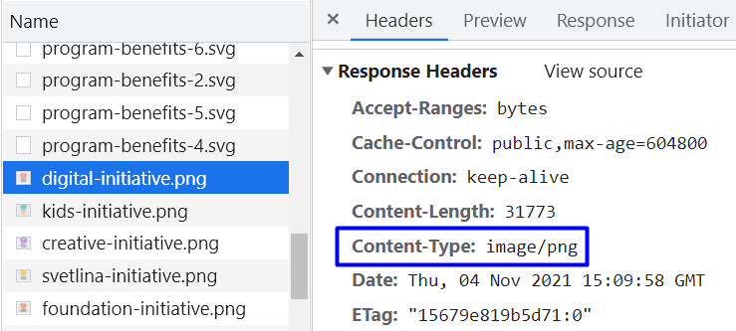
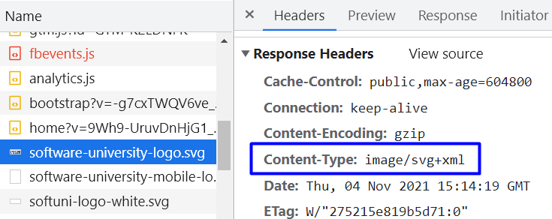
MIME Types – Example
Open the SoftUni site and examine different media and its type on the Home page

Slide 50

Dev Tools
Tools for Developers

Slide 51
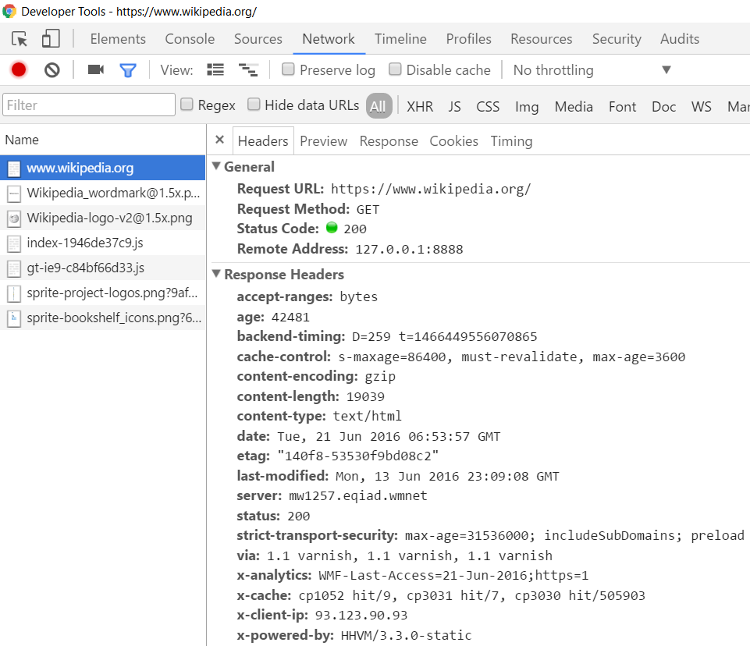
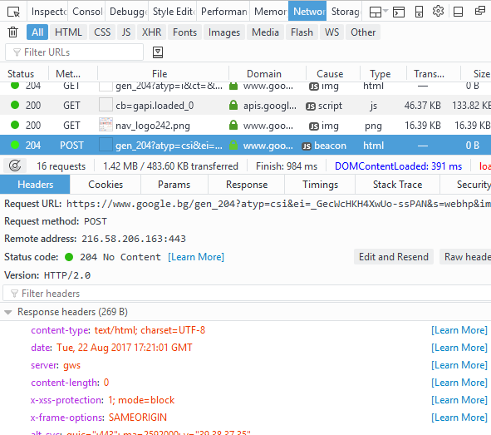
Tools for Developers – Browser Dev Tools
Chrome Developer Tools
Mozilla Developer Tools

Slide 52

Tools for Developers – Browser Add-ons
</>
Postman - Chrome
Rested - Firefox

Slide 53

HTTP Tools for Developers – Desktop
Fiddler
Postman

Slide 54

TCP Networking
TCP Handshake, TCP Listener and Sockets

Slide 55


Transmission Control Protocol (TCP)
Standard for establishing and maintaining a network conversation
Provides error-free data transmission
The connection is established using a three-way handshake
SYN
Synchronize packet

Slide 56
Transmission Control Protocol (TCP)
Standard for establishing and maintaining a network conversation
Provides error-free data transmission
The connection is established using a three-way handshake
SYN - ACK
Synchronize
Acknowledgement

Slide 57
Transmission Control Protocol (TCP)
Standard for establishing and maintaining a network conversation
Provides error-free data transmission
The connection is established using a three-way handshake
ACK
Acknowledgement

Slide 58
Transmission Control Protocol (TCP)
Standard for establishing and maintaining a network conversation
Provides error-free data transmission
The connection is established using a three-way handshake
Connection Established

Slide 59
TCP Listener
Provides methods that listen for and accept incoming connection requests
private static async Task ServerListen()
{
int port = 8000;
IPAddress ipAddress = IPAddress.Parse("127.0.0.1");
TcpListener server = new TcpListener(ipAddress, port);
server.Start();
// Establish а connection and read request
}

Slide 60
TCP Client
Connecting, sending, and receiving stream data over a network
var client = await listener.AcceptTcpClientAsync();
Console.WriteLine("Client connected.");
byte[] buffer = new byte[1024];
client.GetStream().Read(buffer, 0, buffer.Length);
byte[] data = Encoding.ASCII.GetBytes("Hello!");
client.GetStream().Write(data, 0, data.Length);
client.GetStream().Dispose();
Connecting with client

Slide 61
TCP Client
Connecting, sending, and receiving stream data over a network
var client = await listener.AcceptTcpClientAsync();
Console.WriteLine("Client connected.");
byte[] buffer = new byte[1024];
client.GetStream().Read(buffer, 0, buffer.Length);
byte[] data = Encoding.ASCII.GetBytes("Hello!");
client.GetStream().Write(data, 0, data.Length);
client.GetStream().Dispose();
Reads data from client's NetworkStream

Slide 62
TCP Client
Connecting, sending, and receiving stream data over a network
var client = await listener.AcceptTcpClientAsync();
Console.WriteLine("Client connected.");
byte[] buffer = new byte[1024];
client.GetStream().Read(buffer, 0, buffer.Length);
byte[] data = Encoding.ASCII.GetBytes("Hello!");
client.GetStream().Write(data, 0, data.Length);
client.GetStream().Dispose();
Writes data to client's NetworkStream

Slide 63
TCP Client
Connecting, sending, and receiving stream data over a network
var client = await listener.AcceptTcpClientAsync();
Console.WriteLine("Client connected.");
byte[] buffer = new byte[1024];
client.GetStream().Read(buffer, 0, buffer.Length);
byte[] data = Encoding.ASCII.GetBytes("Hello!");
client.GetStream().Write(data, 0, data.Length);
client.GetStream().Dispose();
Closes the NetworkStream

Slide 64
Socket
Provides methods and properties for network communication
var socket = await listener.AcceptSocketAsync();
byte[] buffer = new byte[1024];
socket.Receive(buffer);
byte[] data = Encoding.ASCII.GetBytes("Hello!");
socket.Send(data);
socket.Shutdown(SocketShutdown.Both);
Connecting with client

Slide 65
Socket
Provides methods and properties for network communication
var socket = await listener.AcceptSocketAsync();
byte[] buffer = new byte[1024];
socket.Receive(buffer);
byte[] data = Encoding.ASCII.GetBytes("Hello!");
socket.Send(data);
socket.Shutdown(SocketShutdown.Both);
Receive data from client

Slide 66
Socket
Provides methods and properties for network communication
var socket = await listener.AcceptSocketAsync();
byte[] buffer = new byte[1024];
socket.Receive(buffer);
byte[] data = Encoding.ASCII.GetBytes("Hello!");
socket.Send(data);
socket.Shutdown(SocketShutdown.Both);
Send data to client

Slide 67
Socket
Provides methods and properties for network communication
var socket = await listener.AcceptSocketAsync();
byte[] buffer = new byte[1024];
socket.Receive(buffer);
byte[] data = Encoding.ASCII.GetBytes("Hello!");
socket.Send(data);
socket.Shutdown(SocketShutdown.Both);
Close connection

Slide 68
Socket
Provides methods and properties for network communication
var socket = await listener.AcceptSocketAsync();
byte[] buffer = new byte[1024];
socket.Receive(buffer);
byte[] data = Encoding.ASCII.GetBytes("Hello!");
socket.Send(data);
socket.Shutdown(SocketShutdown.Both);
Options to disable send/receive

Slide 69
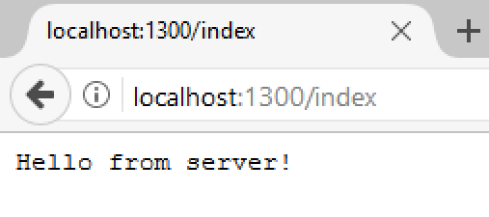
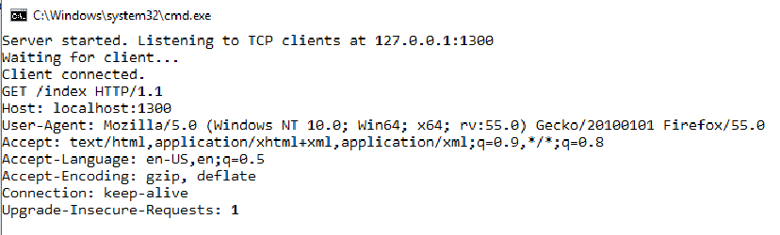
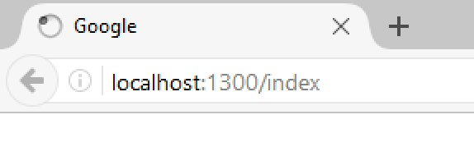
Problem: Simple Web Server
Write a simple web server
Receive a request from a client
Print the request on the console
Write response to client's interface

Slide 70
Solution: Web Server with TcpClient
public async void Connect(TcpListener listener)
{
while (true)
{
// TODO: Accept TcpClient
// TODO: Read request data
// TODO: Send data to client
var message = Encoding.ASCII.GetString(buffer);
Console.WriteLine(message);
client.GetStream().Dispose();
}
}

Slide 71
Solution: Web Server with TcpClient
static void Main()
{
IPAddress address = IPAddress.Parse("127.0.0.1");
int port = 1300;
TcpListener listener = new TcpListener(address, port);
listener.Start();
var task = Task.Run(() => Connect(listener));
task.Wait();
}

Slide 72
Solution: Web Server with Socket
public async void Connect(TcpListener listener)
{
while (true)
{
// TODO: Accept socket
// TODO: Read request data
// TODO: Send data to client
var message = Encoding.ASCII.GetString(buffer);
Console.WriteLine(message);
socket.ShutDown();
}
}

Slide 73

Summary
…
…
…
HTML forms can send 2 types of HTTP requests: GET and POST
HTTP works with message pairs called HTTP request and HTTP response
HTTP headers describe the request / response metadata
See the most used headers here
The URL parts define:
protocol, host, port, path, query string, and fragment

Slide 74
Questions?
Notes:
74

Slide 75











SoftUni Diamond Partners

Slide 76


Educational Partners

Slide 77
Trainings @ Software University (SoftUni)
Software University – High-Quality Education, Profession and Job for Software Developers
softuni.bg, about.softuni.bg
Software University Foundation
softuni.foundation
Software University @ Facebook
facebook.com/SoftwareUniversity
Software University Forums
forum.softuni.bg
77
Notes:
77

Slide 78

License
This course (slides, examples, demos, exercises, homework, documents, videos and other assets) is copyrighted content
Unauthorized copy, reproduction or use is illegal
© SoftUni – https://about.softuni.bg
© Software University – https://softuni.bg
Notes:
78

